Slide 1
Advancing Racial Equity in the City of Kettering
Angela Rahman, Manager
Community Development Division

Slide 2
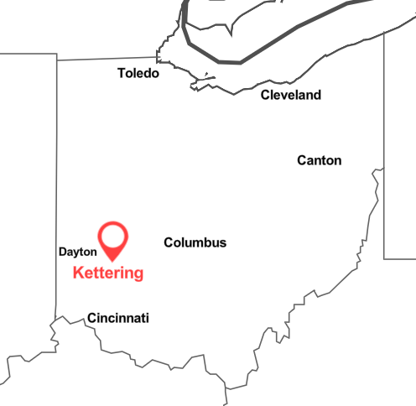
Where is Kettering, OH?

Slide 3
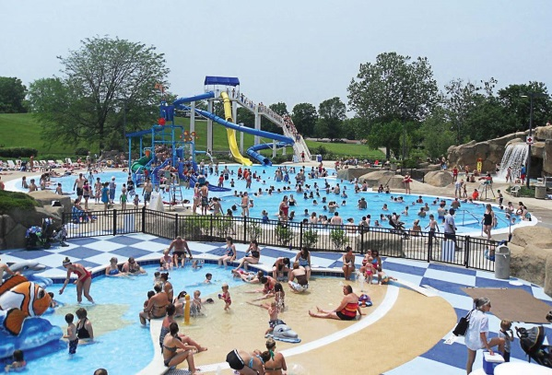
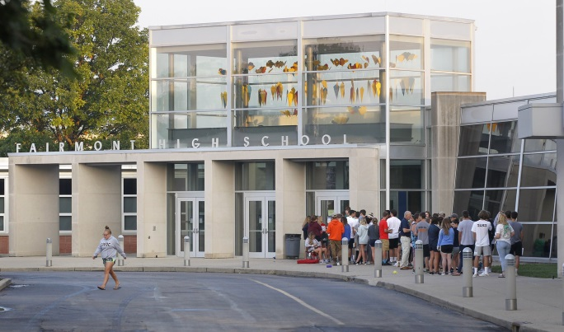
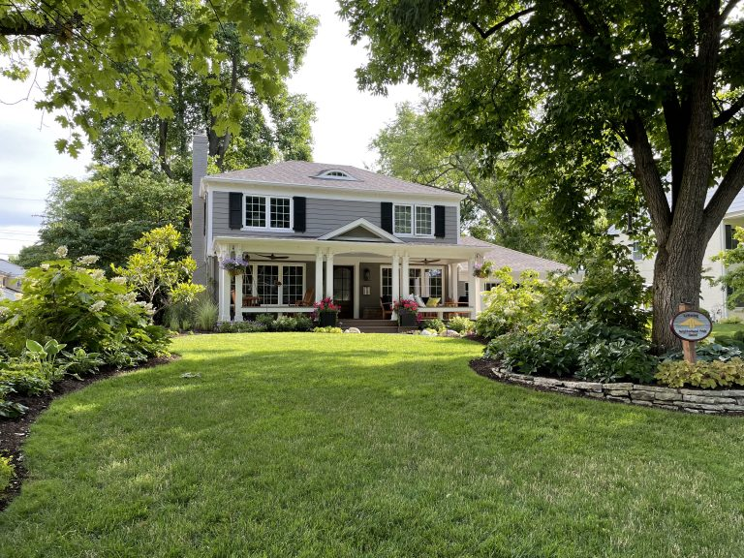
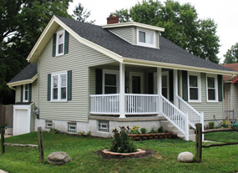
Kettering’s Great Amenities
Adventure Reef Water Park
Kettering Fairmont High School
Hills & Dales MetroPark
Neighborhood Pride Winners

Slide 4
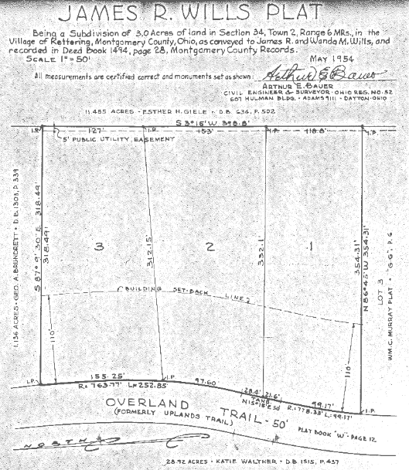
Historic Pattern of Development

Slide 5
Kettering’s Location in the Region

Slide 6
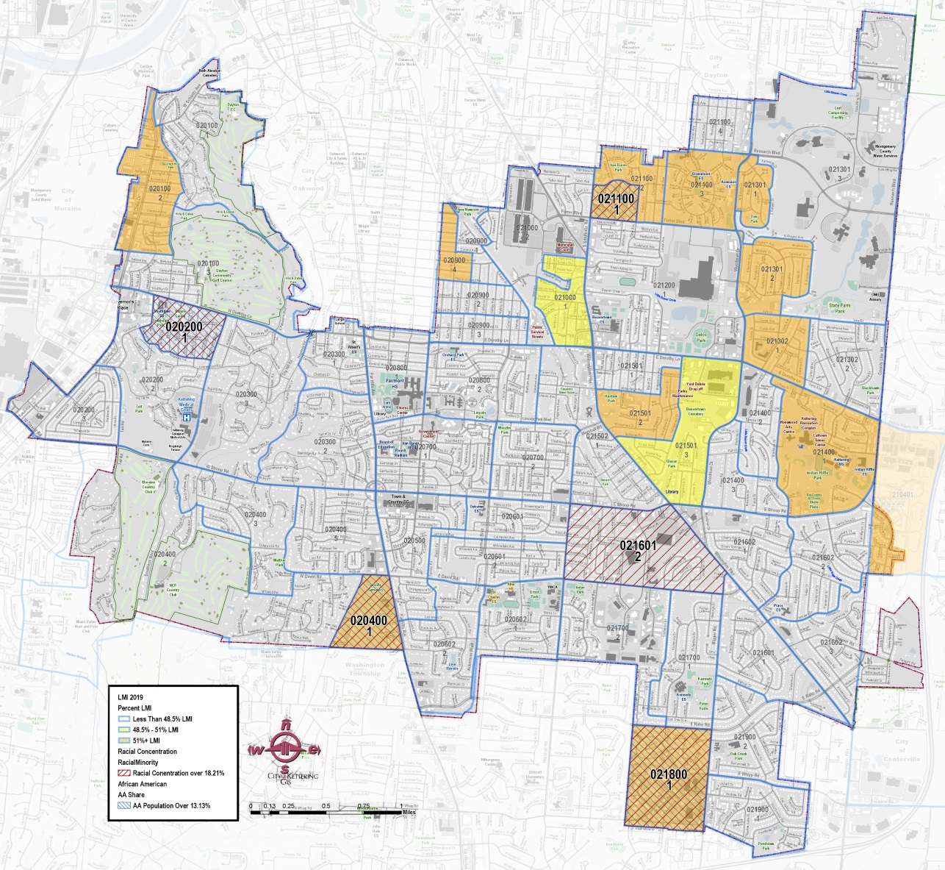
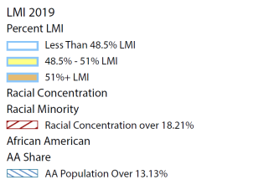
Areas of
Concentration
Kettering LMI by Block Group and Areas of Racial Concentration
Data Sources: US Department of HUD’s CPD’s 2019 LMI data & 2020 Decennial Census (racial data)
Notes:
First look, need to compare with zoning map

Slide 7
How Does Kettering Compare Regionally?
Race Diversity
Kettering
Dayton
Montgomery County
U.S. Census Bureau. (2020). Decennial Census Total Population of Dayton by Race. Retrieved from https://data.census.gov/cedsci/table?q=dayton&tid=DECENNIALPL2020.P1
U.S. Census Bureau. (2020). Decennial Census Total Population of Montgomery County by Race. Retrieved from https://data.census.gov/cedsci/table?g=0500000US39113&tid=DECENNIALPL2020.P1
U.S. Census Bureau. (2020). Decennial Census Total Population of Kettering by Race. Retrieved from https://data.census.gov/cedsci/table?g=1600000US3940040&tid=DECENNIALPL2020.P1
https://worldpopulationreview.com/us-cities/dayton-oh-population
https://datausa.io/profile/geo/montgomery-county-oh#:~:text=The%205%20largest%20ethnic%20groups,(Hispanic)%20(1.52%25).

Slide 8
Regional Poverty
Poverty by Race
Kettering
Dayton
Montgomery County
U.S. Census Bureau. (2020). Poverty Status of Dayton Residents by Race, Within the Past 12 Months. Retrieved from https://data.census.gov/cedsci/table?q=dayton&t=Income%20and%20Poverty&tid=ACSST5Y2020.S1701
U.S. Census Bureau. (2020). Poverty Status of Montgomery County Residents by Race, Within the Past 12 Months. Retrieved from https://data.census.gov/cedsci/table?t=Income%20and%20Poverty&g=0500000US39113&tid=ACSST5Y2020.S1701
U.S. Census Bureau. (2019). Poverty Status of Kettering Residents by Race, Within the Past 12 Months. Retrieved from https://worldpopulationreview.com/us-cities/kettering-oh-population , https://data.census.gov/cedsci/table?tid=ACSST5Y2019.S1701&g=1600000US3940040
https://datausa.io/profile/geo/dayton-oh/
https://datausa.io/profile/geo/montgomery-county-oh#:~:text=The%205%20largest%20ethnic%20groups,(Hispanic)%20(1.52%25).

Slide 9
Home Owner
Renter
- 114,851
- 51,876
- 19,026
- 29,270
- 17,594
- 13,333
- 9,032
- 15,758
- 14,960
- 8,066
- 148
- 927
U.S. Census Bureau. (2020). B25003A Tenure + Race in Montgomery County. Retrieved from https://data.census.gov/cedsci/table?t=Owner%2FRenter%20%28Tenure%29%3ARace%20and%20Ethnicity&g=0500000US39113
U.S. Census Bureau. (2020). B25003A Tenure + Race in Dayton. Retrieved from https://data.census.gov/cedsci/table?t=Owner%2FRenter%20%28Tenure%29%3ARace%20and%20Ethnicity&g=1600000US3921000&tid=ACSDT5Y2020.B25003B
U.S. Census Bureau. (2020). B25003A Tenure + Race in Dayton. Retrieved from https://data.census.gov/cedsci/table?t=Owner%2FRenter%20%28Tenure%29%3ARace%20and%20Ethnicity&g=1600000US3940040
Home Owner
Renter

Slide 10
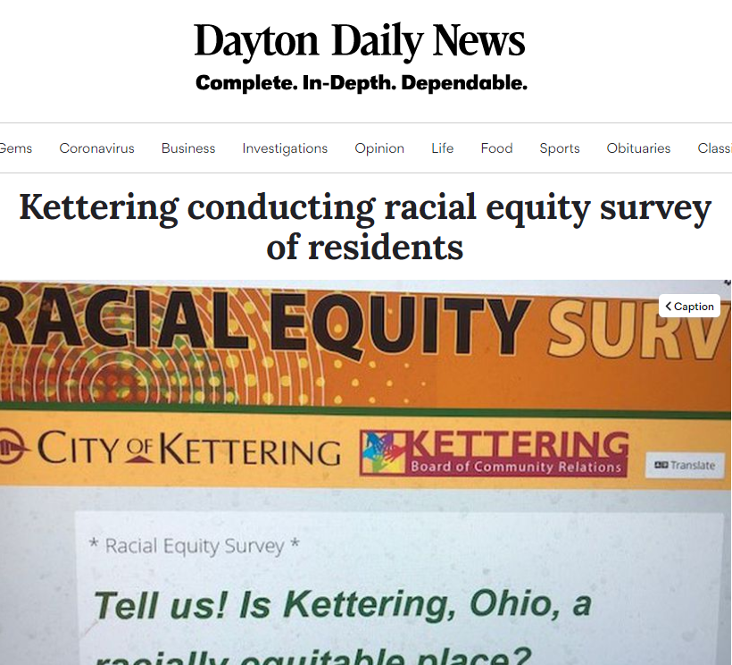
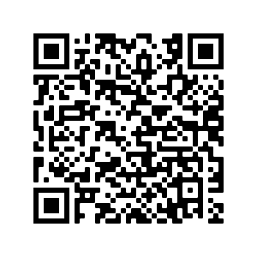
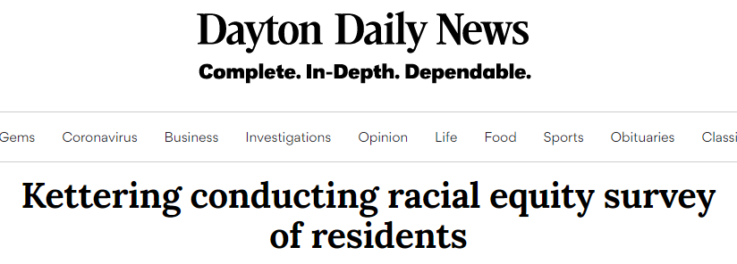
Racial Equity in a White Space
In early 2021 the City of Kettering published the Racial Equity Survey with the goal of understanding race relations in Kettering.
Link to survey and report
Notes:
Angela needs to add

Slide 11
How it Happened
The idea came from the City‘s Board of Community Relations during the racial reckoning that occurred as the result of George Floyd’s murder in 2020. With City Council’s buy in and funding, the survey was developed.
In the end nearly 550 unique residents responded to the survey giving us confidence at the 95% level, with 400 unique comments.

Slide 12
Qualitative Findings
There are conflicting views on race relations in Kettering, however, on average residents believe they are more positive than they are negative.
Many agreed that there is a lack of diversity .
Some attempted to redefine racism, arguing that those who talked about race were the real racists. Others brought up systemic issues that have influenced all U.S. cities.

Slide 13
Race Relations
What we asked of respondents:
Indicate the degree to which race relations between white residents and residents who are people of color are positive or negative in 2020.
Indicate to what degree they worry about race relations in Kettering.
Whether they believed that racist actions have been increasing in Kettering
How satisfied are they with how residents of color are treated in Kettering
66%
of the population in Kettering worries at least a little about race relations.
Do you feel racist actions are on the rise?

Slide 14
Diversity
What we asked:
Degree of equitable treatment by institutions experienced by white applicants and applicants who are People of Color in the City of Kettering
“I see few community leaders of color, few police of color, and I think it’s a problem for everyone.”
Institutional Trust

Slide 15
How Diverse Are Your Networks?
“There are a few people of color in the neighborhood but other than saying ‘hello’ in passing, I don’t have much contact with them”
Think of the 10 people you spend the most time with. How many of these are People of Color?
40% of residents reported that of the 10 people they spend the most time with, none are People of Color. In total 80% said that they had 3 or fewer close contacts of color .
Residents have described a lack of diversity and representation in the city

Slide 16
Potential Overtones
Respondents pointed out directly that there is a lack of understanding or trust between races. This was further showcased by the way other respondents reacted to questions about race.
I believe POC are treated different in shopping and renting in Kettering, and not for the better.
My adopted son is black… I very much worry about the future. I worry he will be in danger.
My wife and kids are ‘people of color’ and have had no issues.
As a Hispanic who has experienced racism, I feel very safe in Kettering.
As a mother of two black children, I spend considerable time concerned about race.
I am tired of being told I’m a racist white person and a terrorist
My son who is black is uncomfortable coming into Kettering due to treatment he receives...
Stop the hunt for so called ‘white supremacists’
everyone has the
same opportunity…

Slide 17
Next Steps
Community Events
Diversity, Equity and Inclusion Training for city employees and city boards
Outreach
Programming

Slide 18
Programming
Notes:
Talk about the success, how we started with $500,000

Slide 19
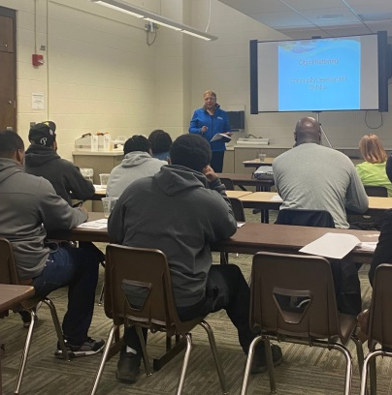
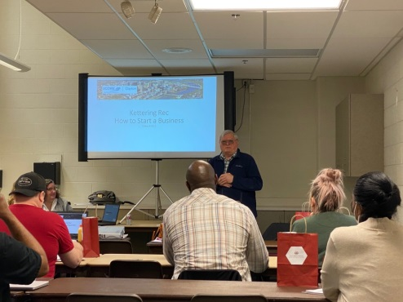
Minority Microenterprise Grant
3 Prong Approach:
Education
Connection
Funding
Qualifications:
Five or fewer employees –one of whom is a moderate income owner
Historically disadvantaged racial or ethnic group

Slide 20
QUESTIONS?
Angela Rahman
Community Development Manager
937-296-2524
Angela.Rahman@ketteringoh.org

